Slide 1



Study Jam

Slide 2
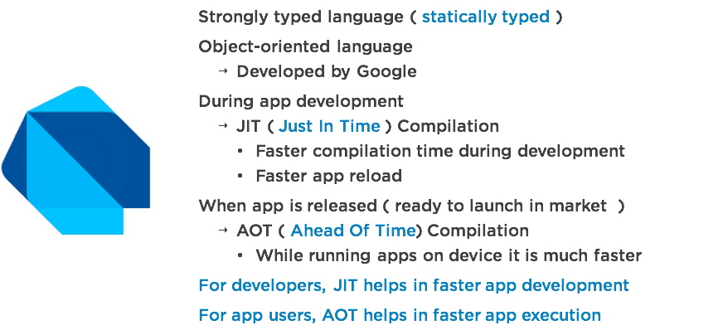
Flutter uses Dart

Slide 3
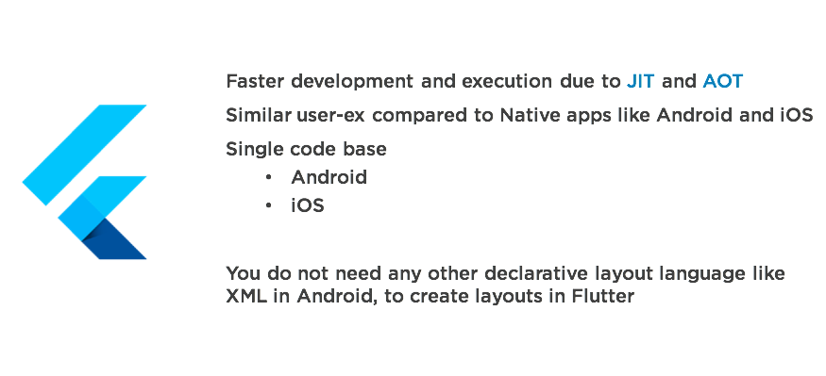
Flutter is Different

Slide 4
Dart Codelab
https://bit.ly/dart-lab

Slide 5
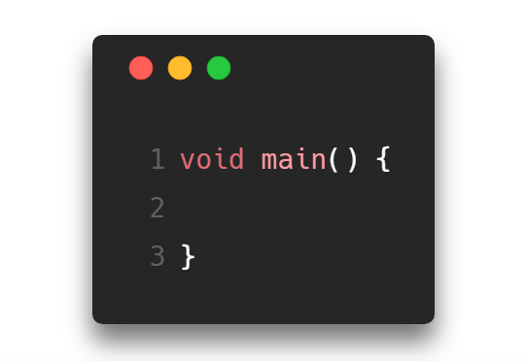
Dart files should have .dart extensions
Every program starts with a main function. Entry point to your Dart application.

Slide 6
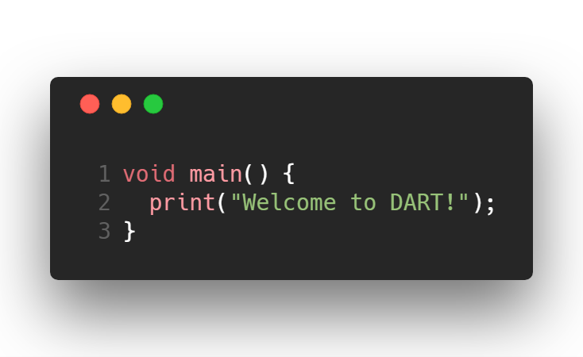
Print to console

Slide 7
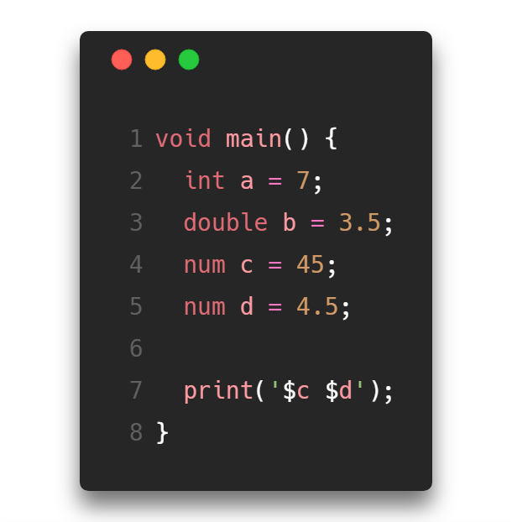
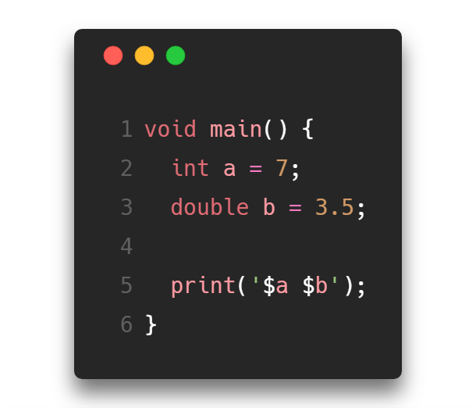
Data Type : Numbers

Slide 8
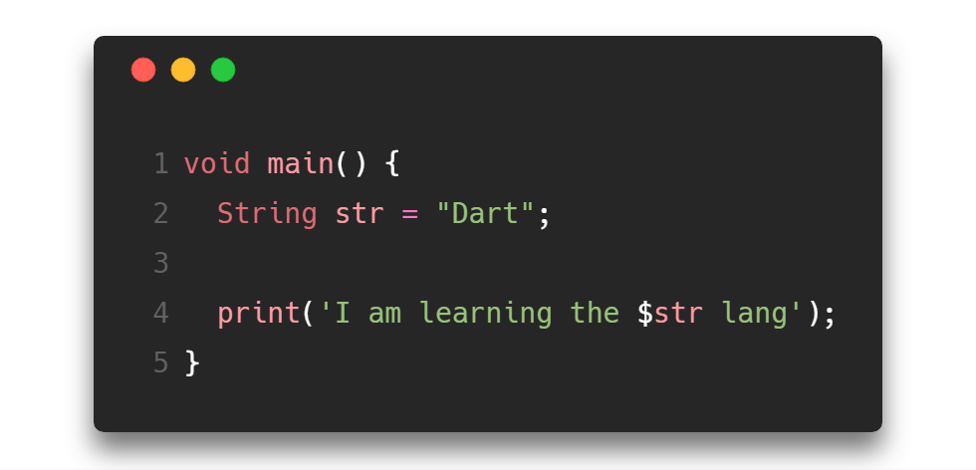
Datatype: Strings

Slide 9
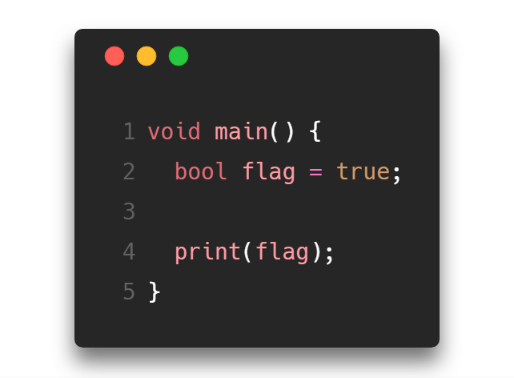
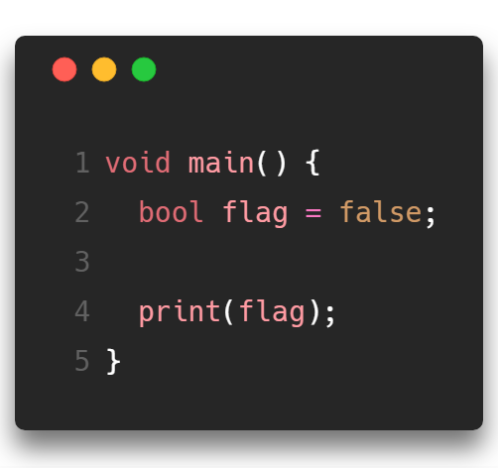
Datatype: Booleans

Slide 10
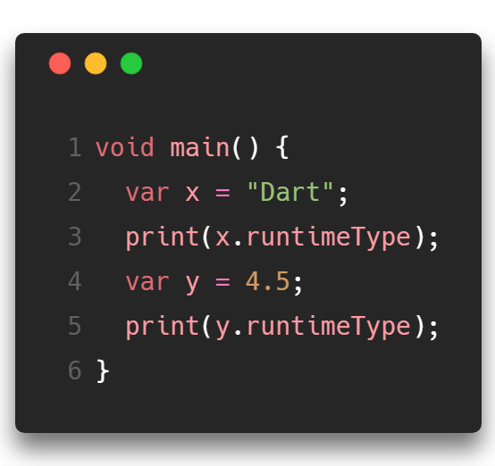
var is a keyword that can declare any data type
runtimeType prints the type of the variable declared

Slide 11
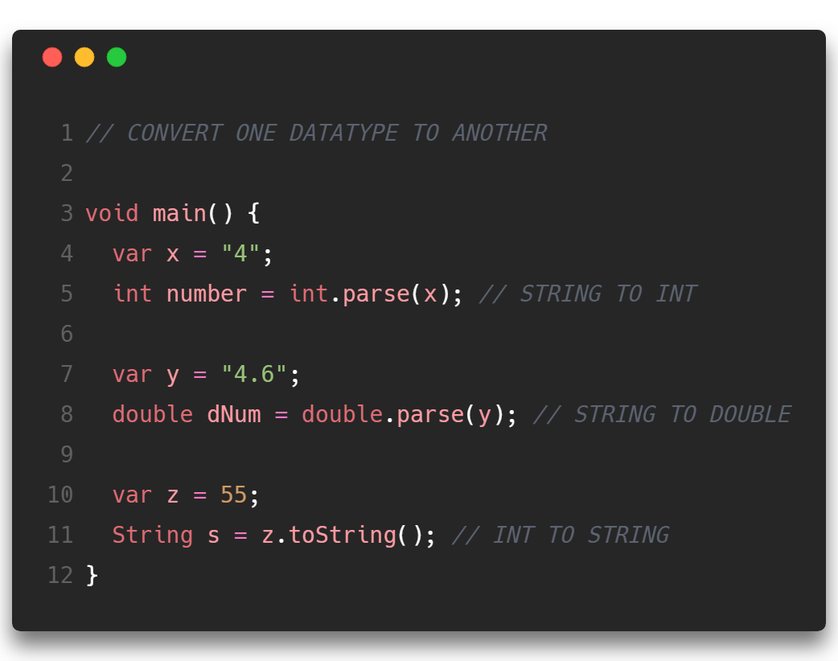

Slide 12
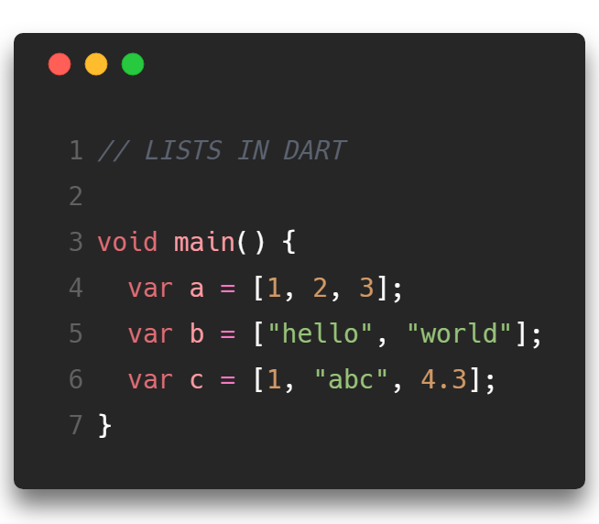
Notes:
Print the runtime type of each variable

Slide 13
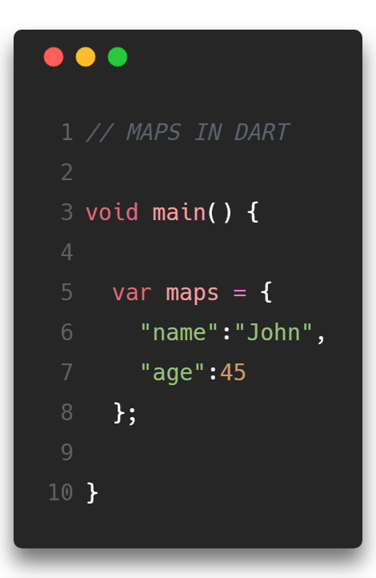
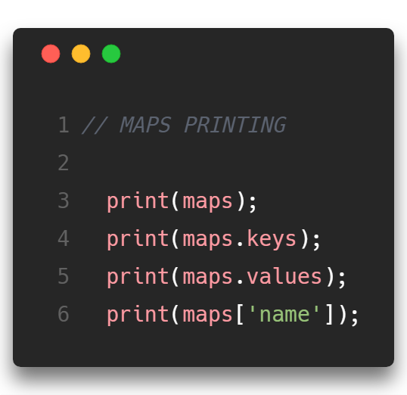

Slide 14
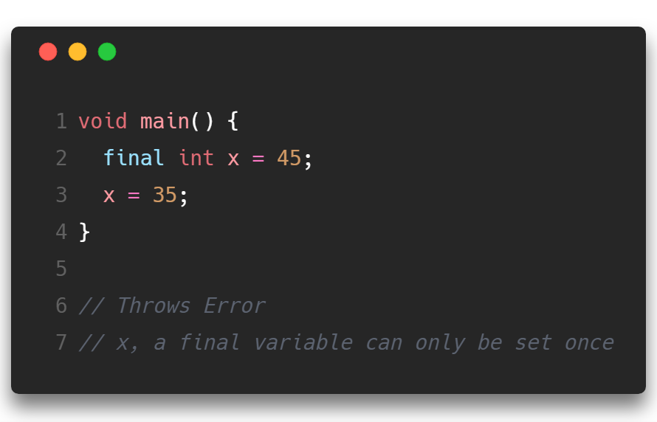

Slide 15
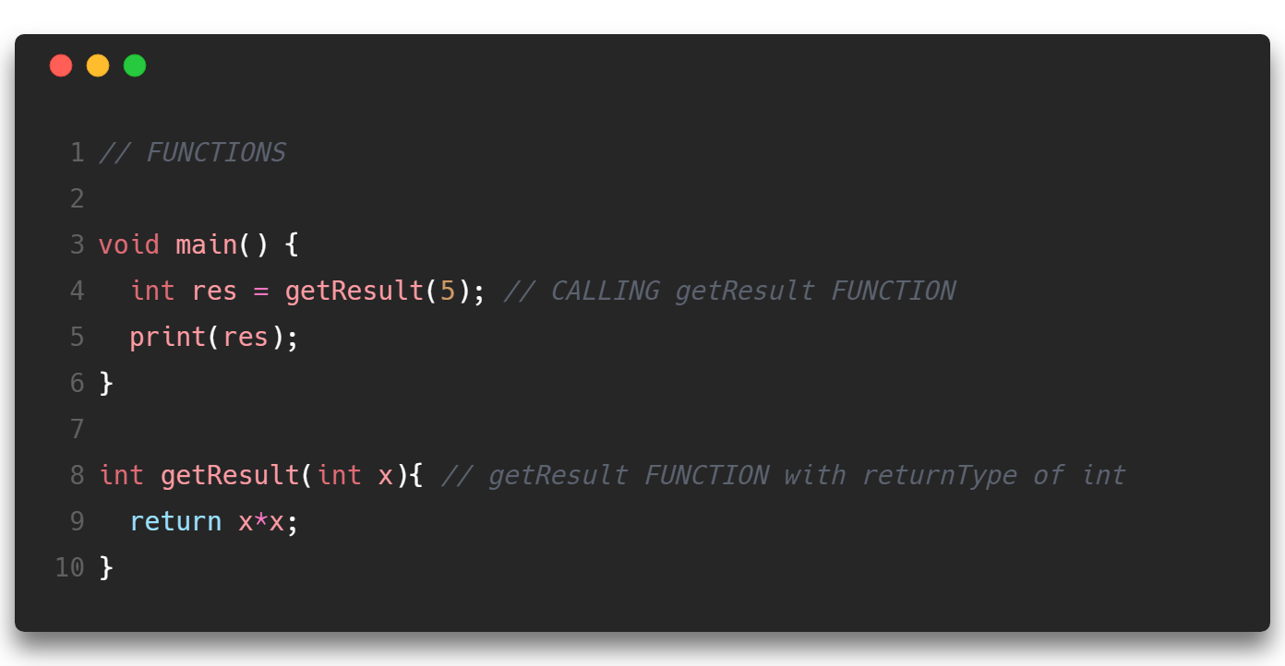

Slide 16
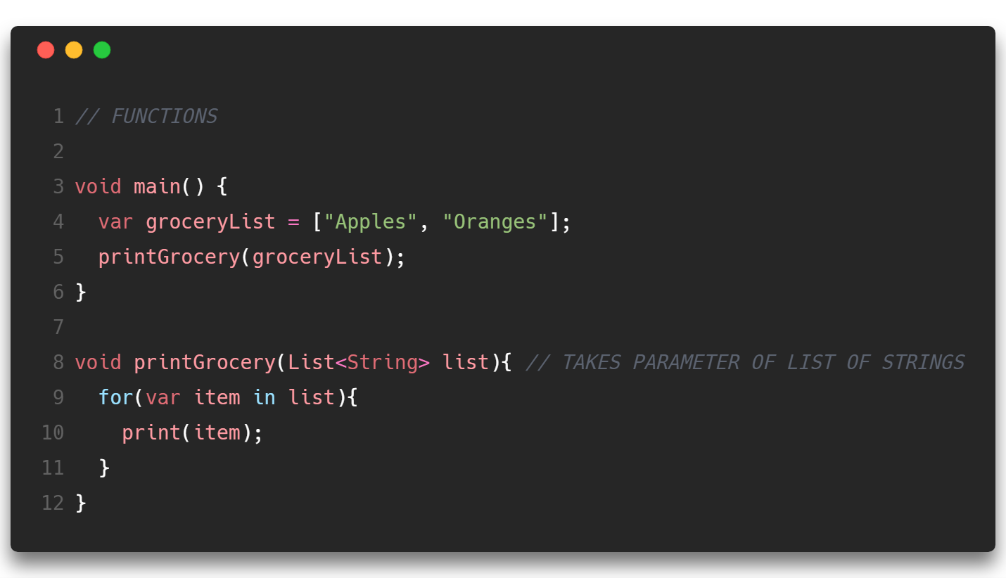

Slide 17
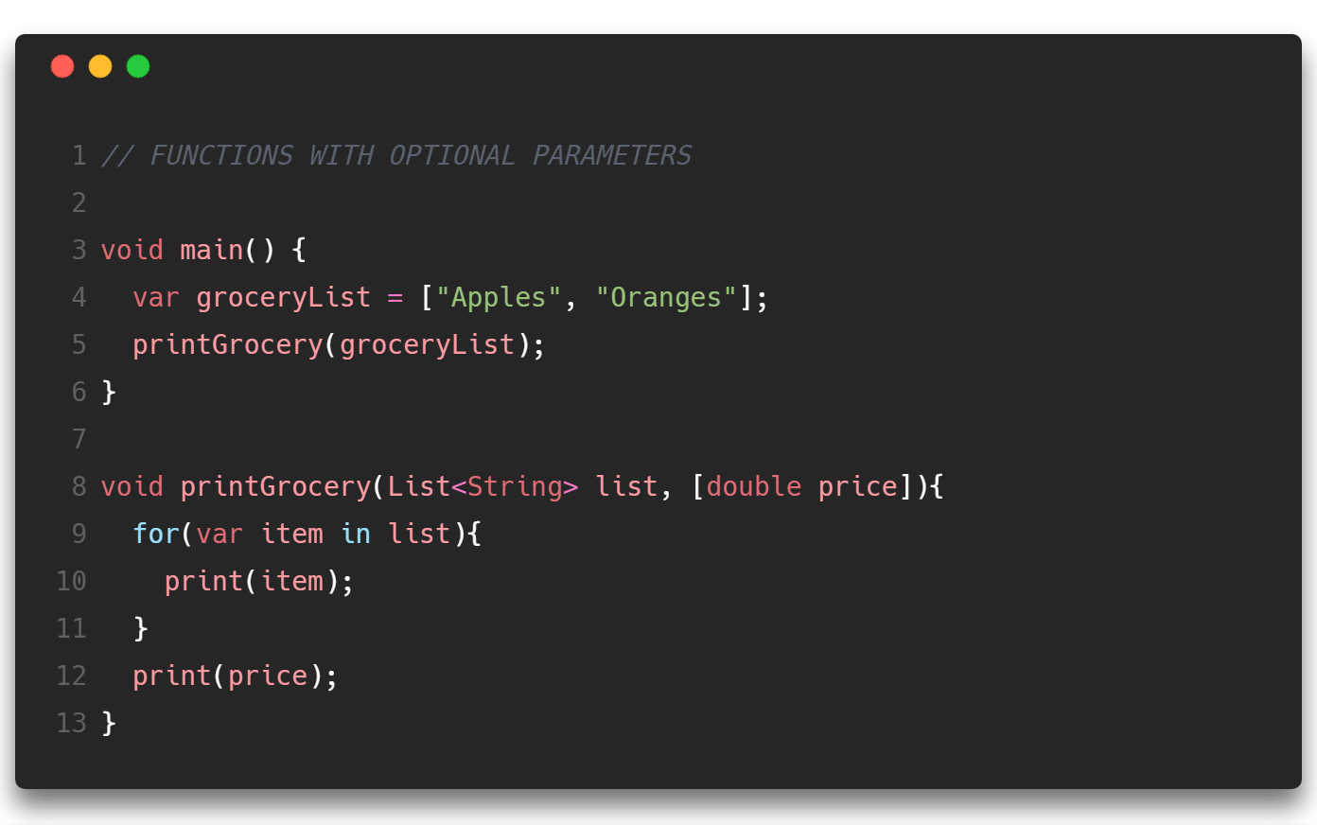

Slide 18
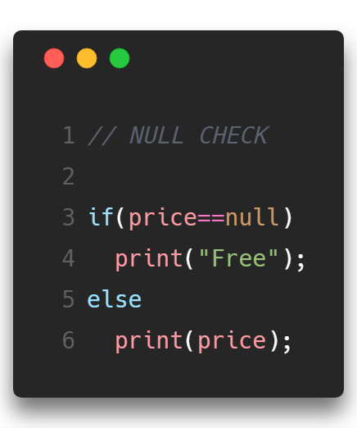
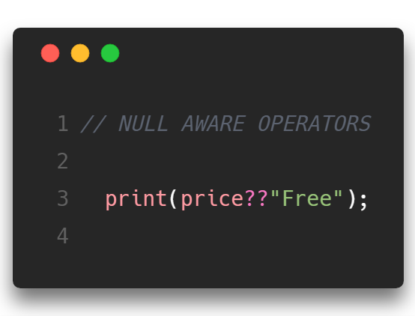

Slide 19
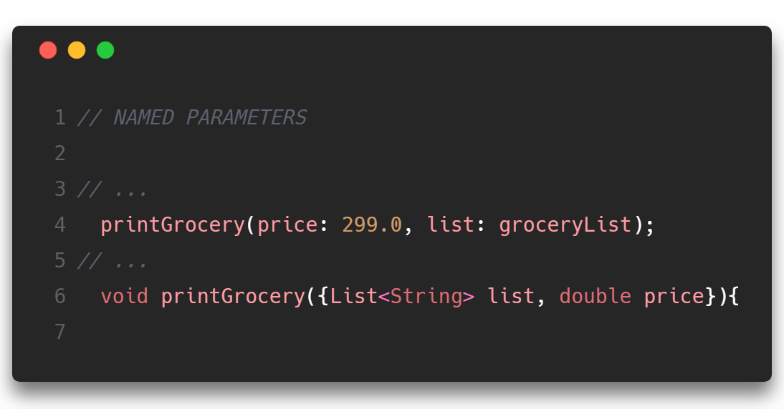

Slide 20
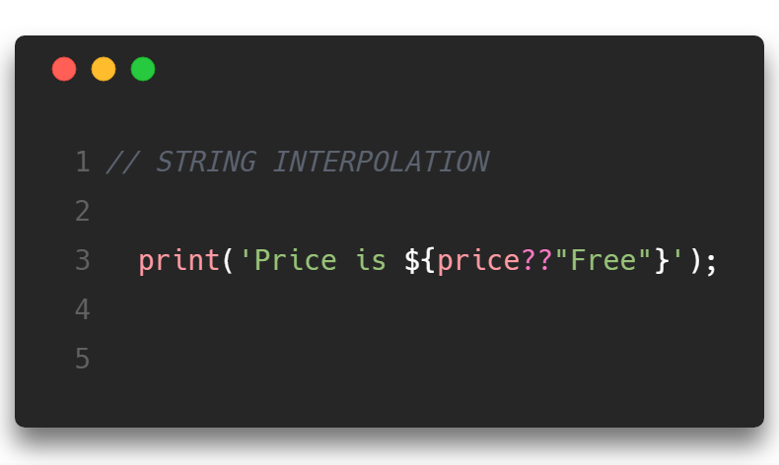

Slide 21
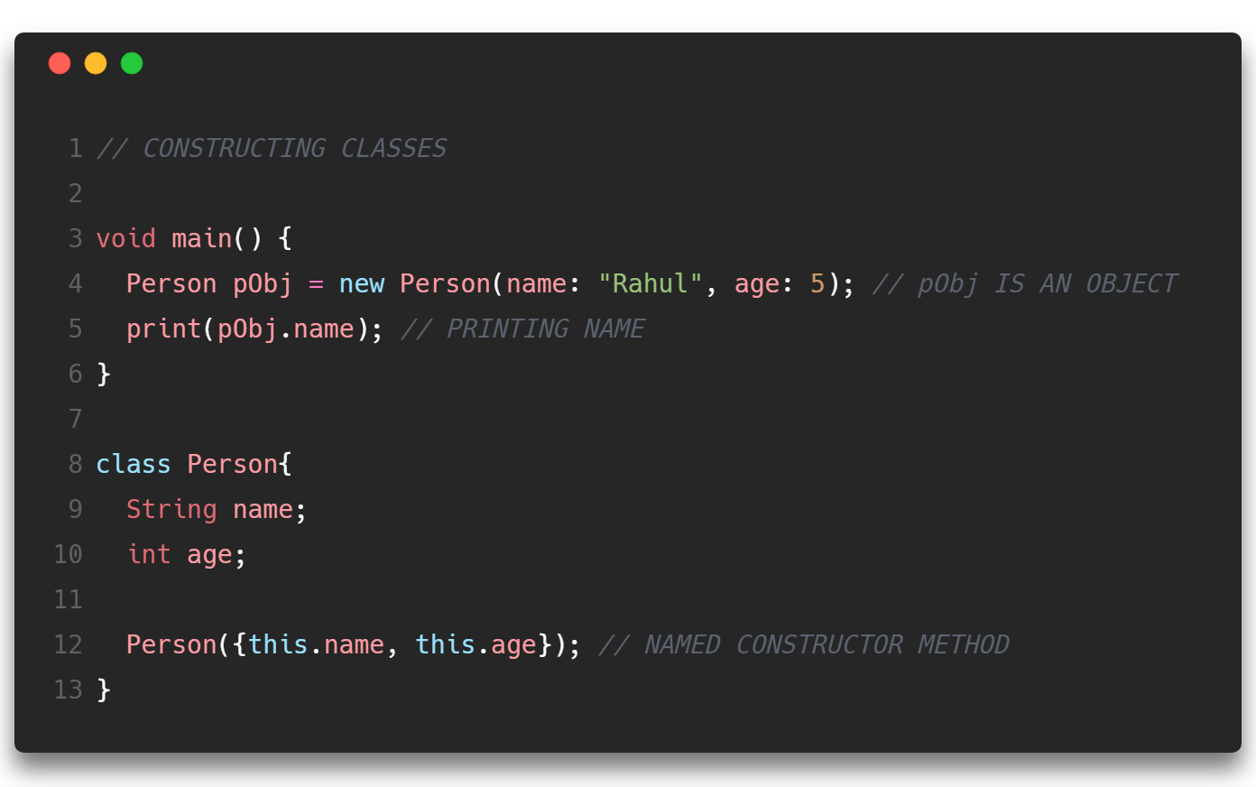

Slide 22
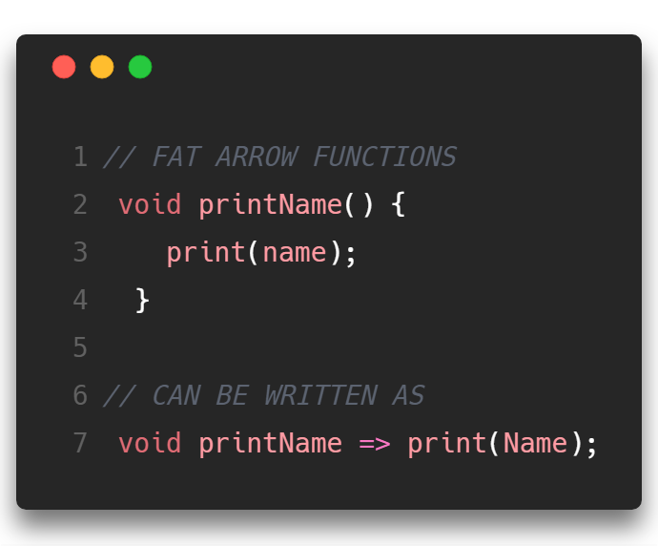

Slide 23
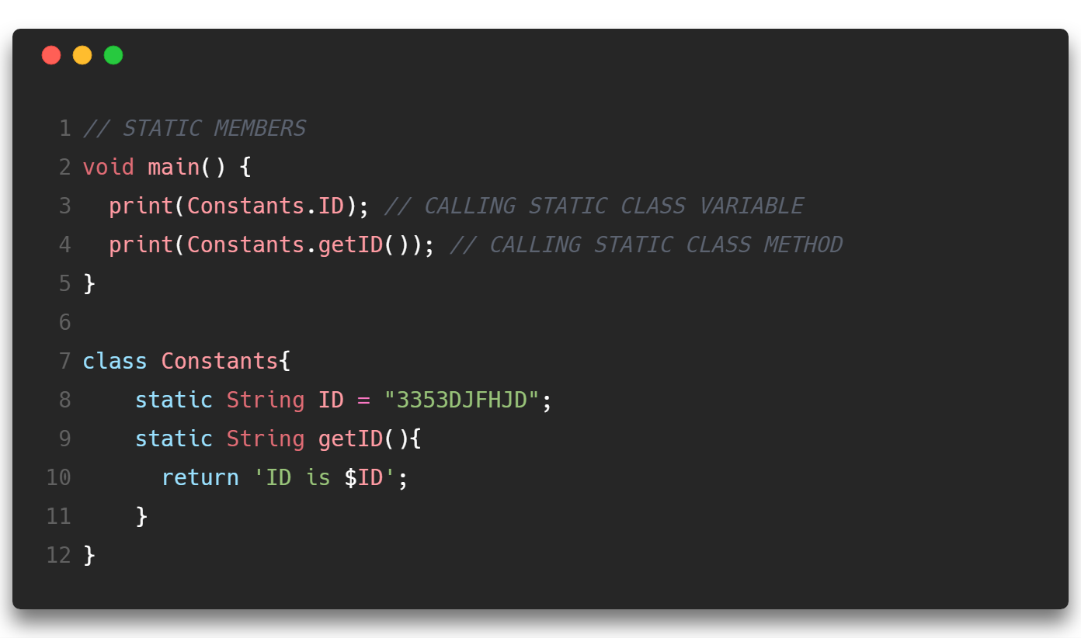

Slide 24
More Dart Resources
https://www.youtube.com/watch?v=5rtujDjt50I&list=PLlxmoA0rQ-LyHW9voBdNo4gEEIh0SjG-q
https://codelabs.developers.google.com/codelabs/from-java-to-dart
https://hackr.io/tutorials/learn-dart

